Slide 1
SAP EWM EXTENDED WAREHOUSE MANAGEMENT TRAINING
AnubhavTrainings.com
www.anubhavtrainings.com

Slide 2

SAP EWM TRAINING
BY:-
Mr. Bijoy
www.anubhavtrainings.com
Notes:
https://unsplash.com/photos/uXB-7la5vqA

Slide 3
Serial Number management
Serial number concept in EWM and Configuration
Serial number testing execution

Slide 4
Serial Number Management
Serial number profile plays an important role in the warehouse to track the material by serial number.
Character string that is given to a product in addition to a product number in order to differentiate the individual piece from all the other pieces. The combination of product number and serial number is unique.
The main difference between batch and serial numbers is that batch numbers are used for a group of products manufactured at the same time. Serial numbers are unique numbers assigned to specific items.
ERP Side Configuration -
Determine serial number profile
IMG-Logistics Execution-Shipping-Basic Shipping Functions-Serial Numbers-Determine Serial Number Profiles

Slide 5
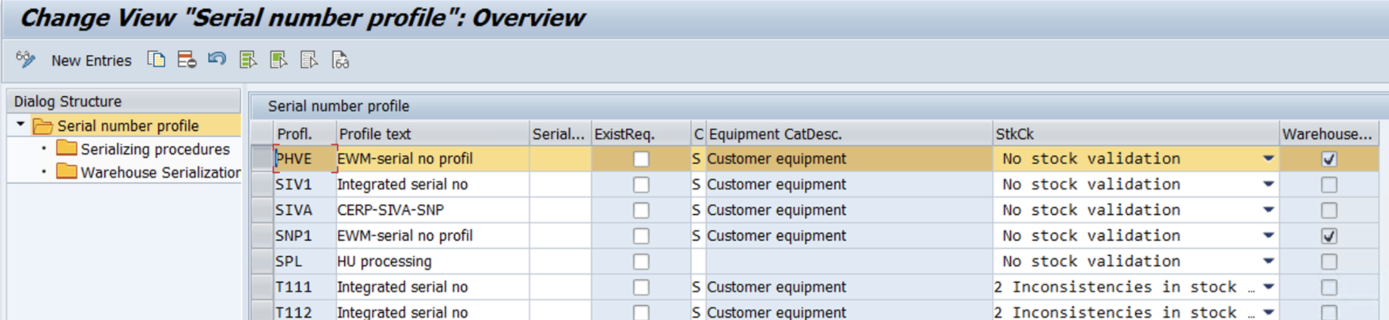
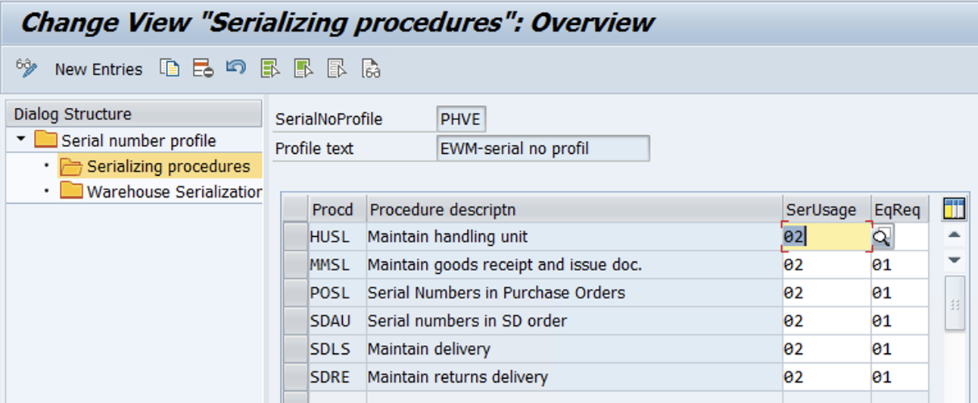

Slide 6
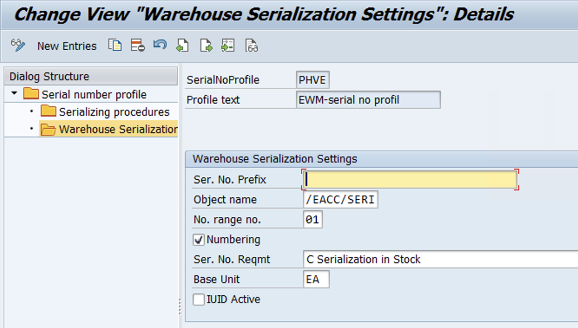

Slide 7
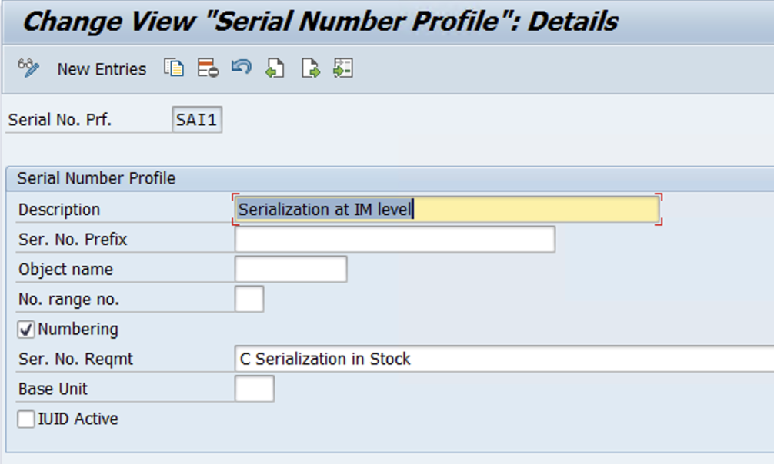
EWM relevant serial number profile
IMG - Integration with Other SAP Components- Extended Warehouse Management- Additional Material Attributes- Attribute Values for Additional Material Master Fields- Define Serial Number Profile
www.anubhavtrainings.com

Slide 8
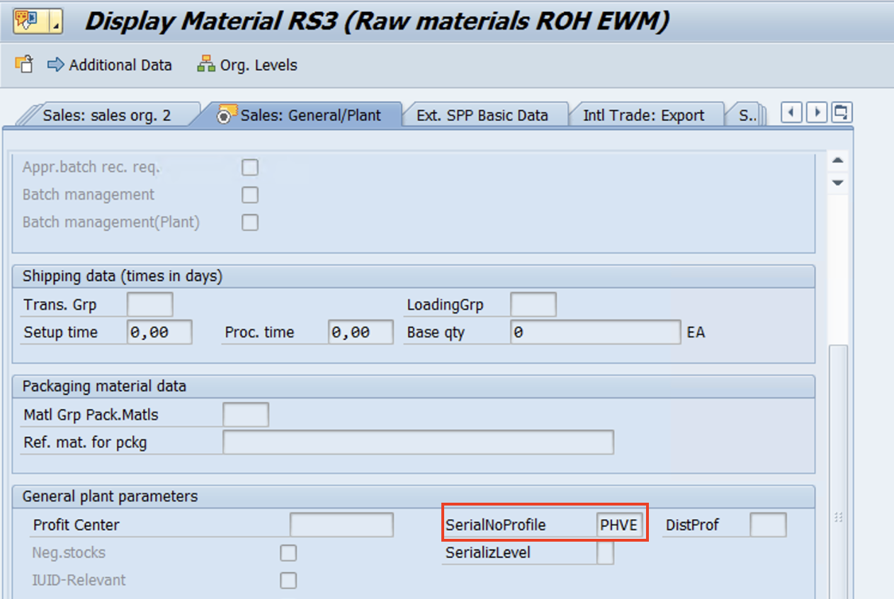
Serialization at IM level
Create Material – maintain Sales general data & WM execution views
www.anubhavtrainings.com

Slide 9
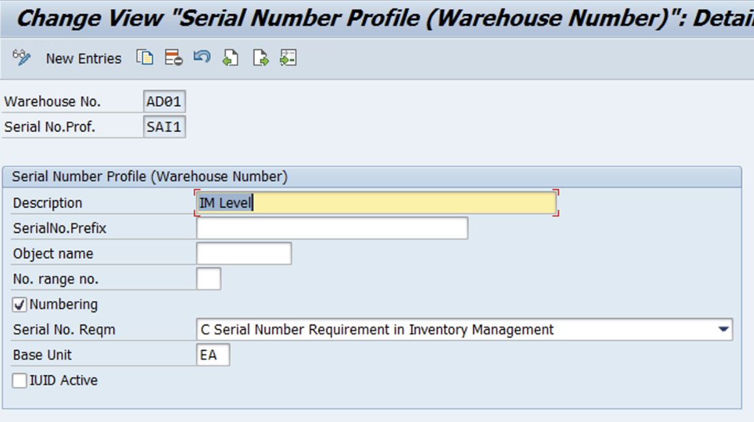
Define Warehouse Number-Dependent Serial Number Profiles
IMG- SCM Extended Warehouse Management- Extended Warehouse Management- Master Data-Product- Define Serial Number Profile-Define Warehouse Number-Dependent Serial Number Profiles

Slide 10
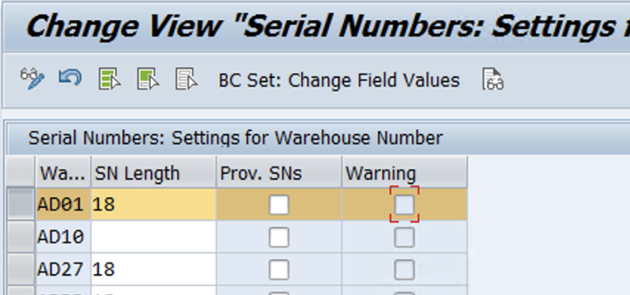
Settings for Warehouse Number
IMG- SCM Extended Warehouse Management- Extended Warehouse Management- Master Data-Product- Serial Number Profile – Setting for Warehouse number

Slide 11
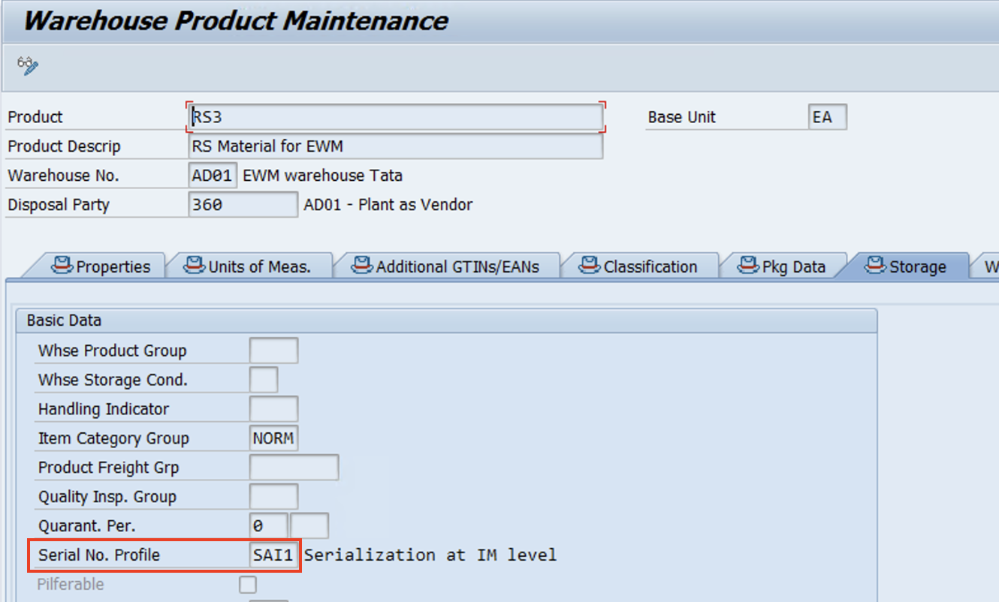
Maintain Warehouse Product master

Slide 12
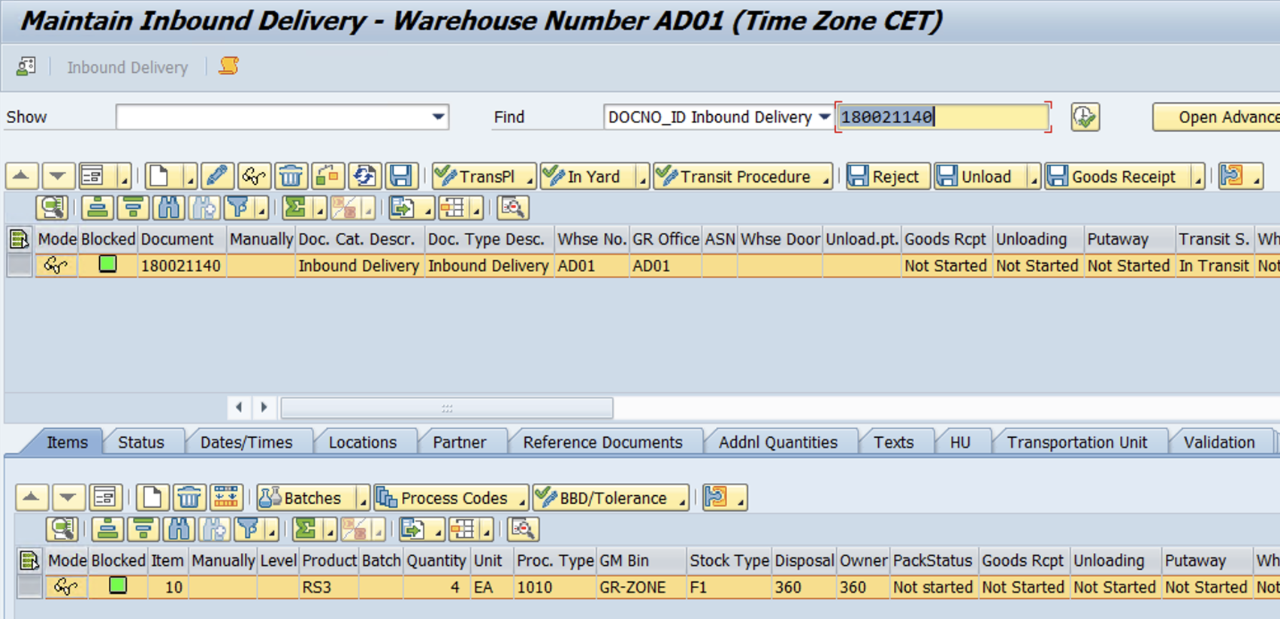
Test Case
Inbound Delivery
www.anubhavtrainings.com

Slide 13
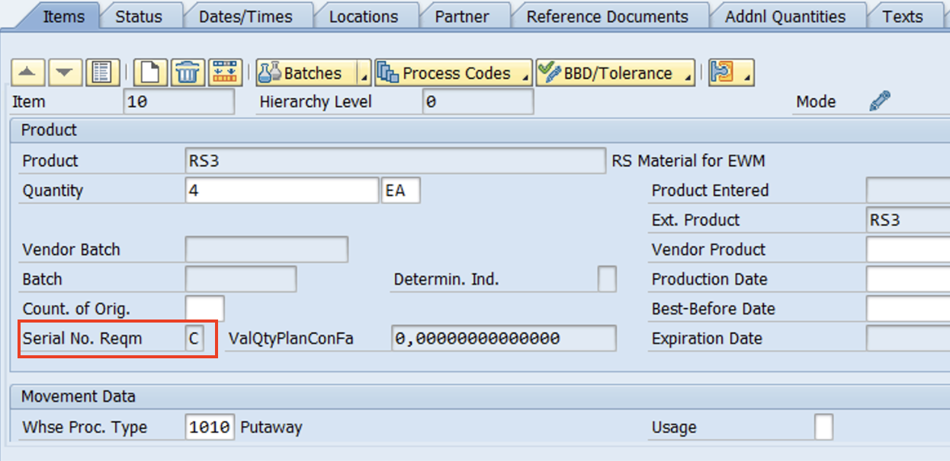
Enter Serial Number
www.anubhavtrainings.com

Slide 14
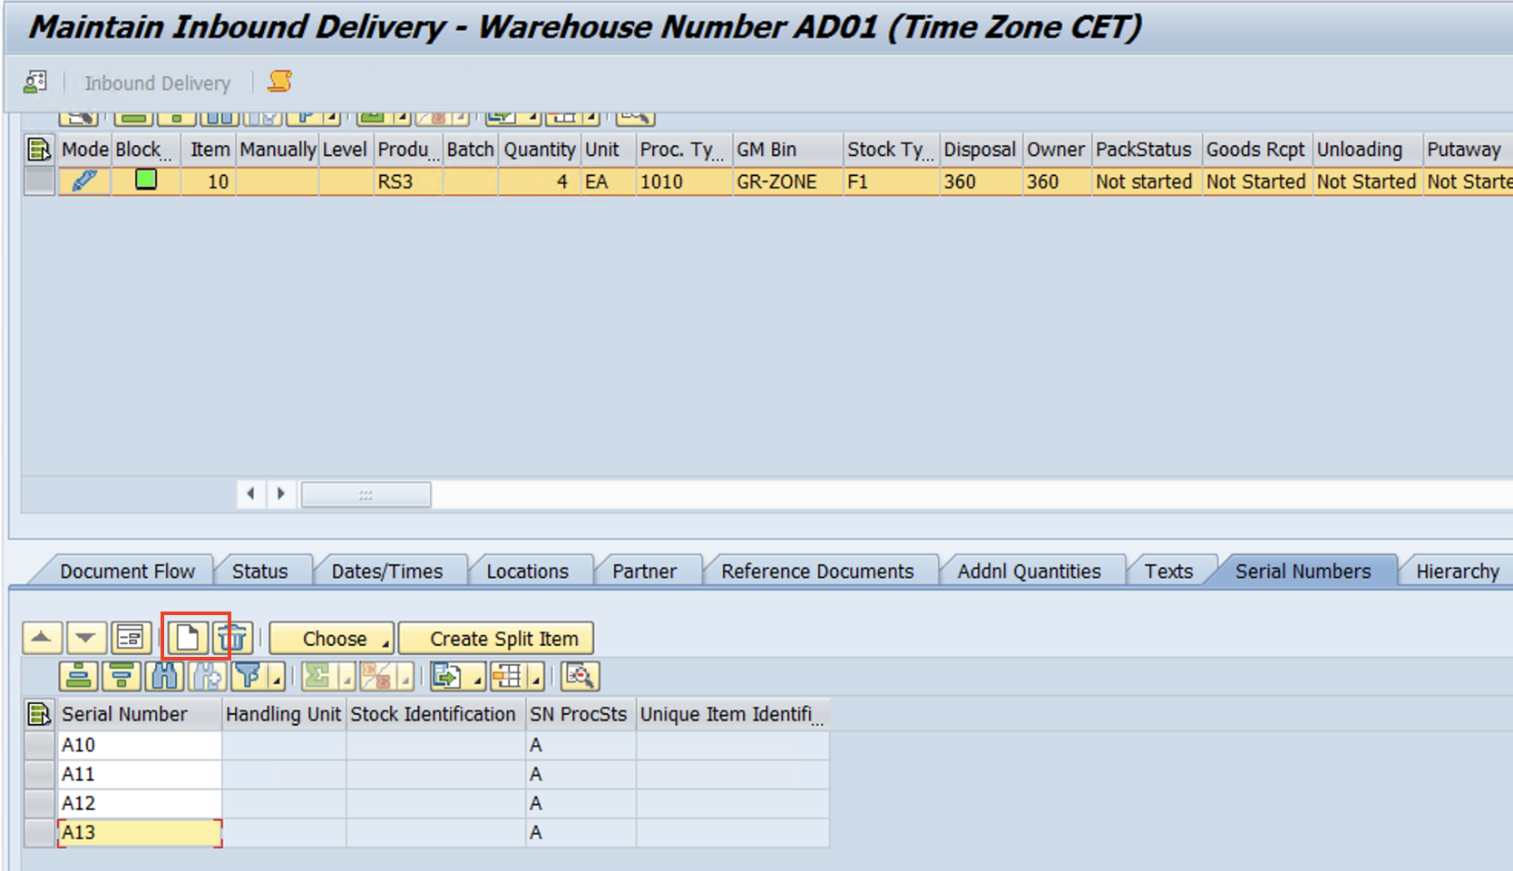
www.anubhavtrainings.com

Slide 15
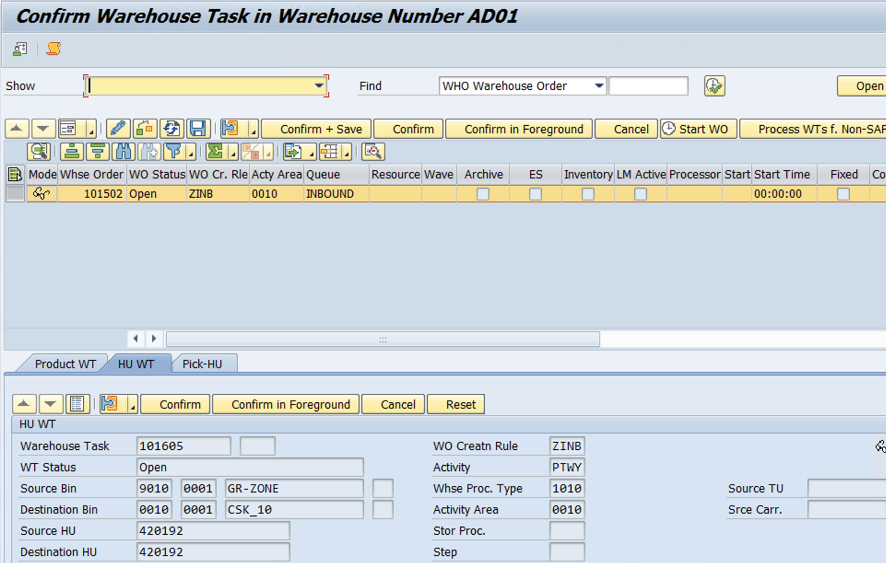
Packing >> GR >> Create Warehouse Tasks
www.anubhavtrainings.com

Slide 16
VAS (Value added services)
VAS Concept understanding, VAS Configuration with POSC process
Test scenarios of VAS process in EWM
Serial number concept in EWM and Configuration
Serial number testing execution

Slide 17

Value Added Services
There are some products which needs VAS activities such as labelling, painting, polishing assembling, packing etc. Additionally, there are materials which needs to be stored for a long time in a warehouse and this would require VAS activities like oiling and repacking before storage.
VAS processes can be employed either in inbound or outbound processes. Moreover, it can be performed alongside kit to stock and kit to order processes. The VAS activities will be carried out in a special work center called VAS work center. The following approach discussed in this blog post explains the VAS order in inbound process with POSC (Process oriented storage control).

Slide 18
Solution Approach:
The below mentioned configuration steps can be employed to achieve this functionality:
In this case, goods are passed through various locations in the warehouse before reaching the final put away. To achieve each movement, a warehouse task has to be created and for every warehouse task creation a warehouse process type needs to be defined.
Process Flow -
Door to GR Zone >> GR Zone to VAS Work center >> VAS Activities >> VAS WC to Final bin
1. Warehouse Process Type- A100 (To move Goods from Door to GR Zone)
www.anubhavtrainings.com

Slide 19
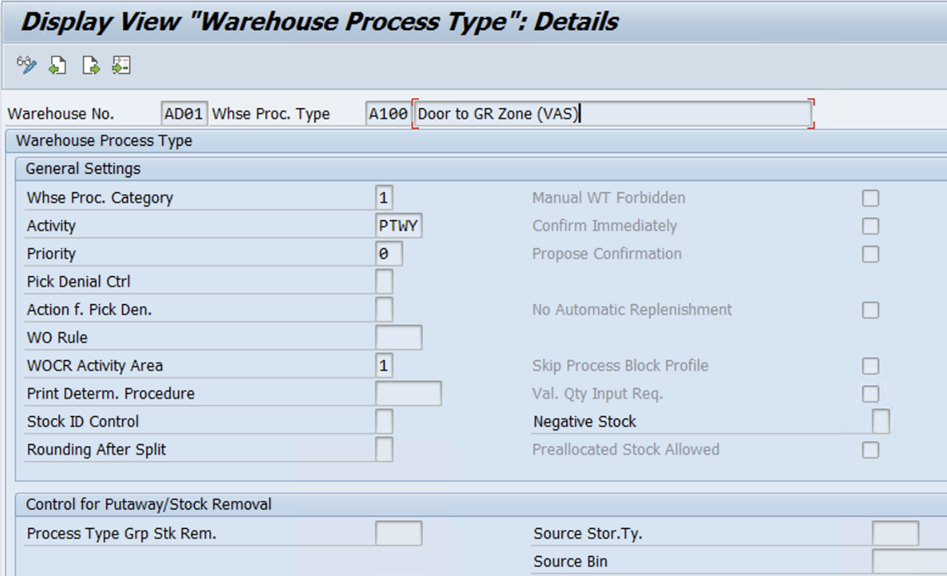
www.anubhavtrainings.com

Slide 20
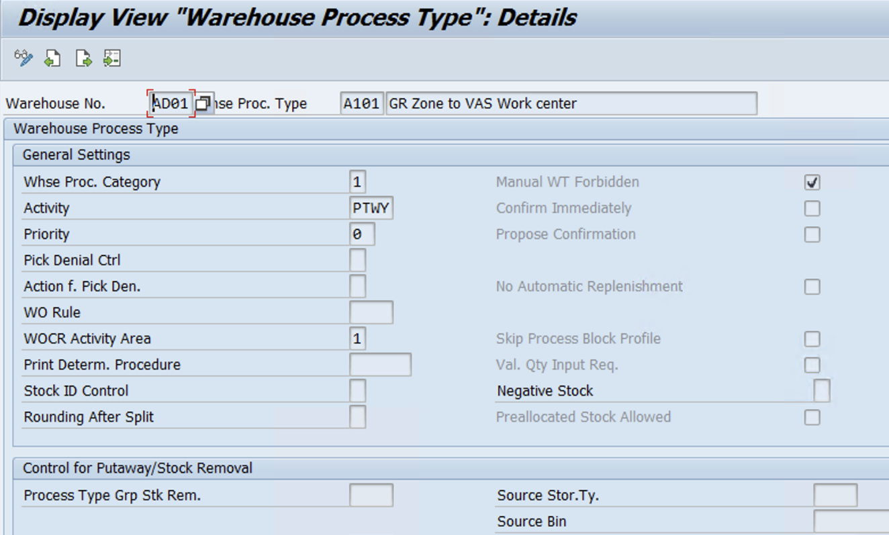
1. Warehouse Process Type- A101 (GR Zone to VAS work center)
www.anubhavtrainings.com

Slide 21
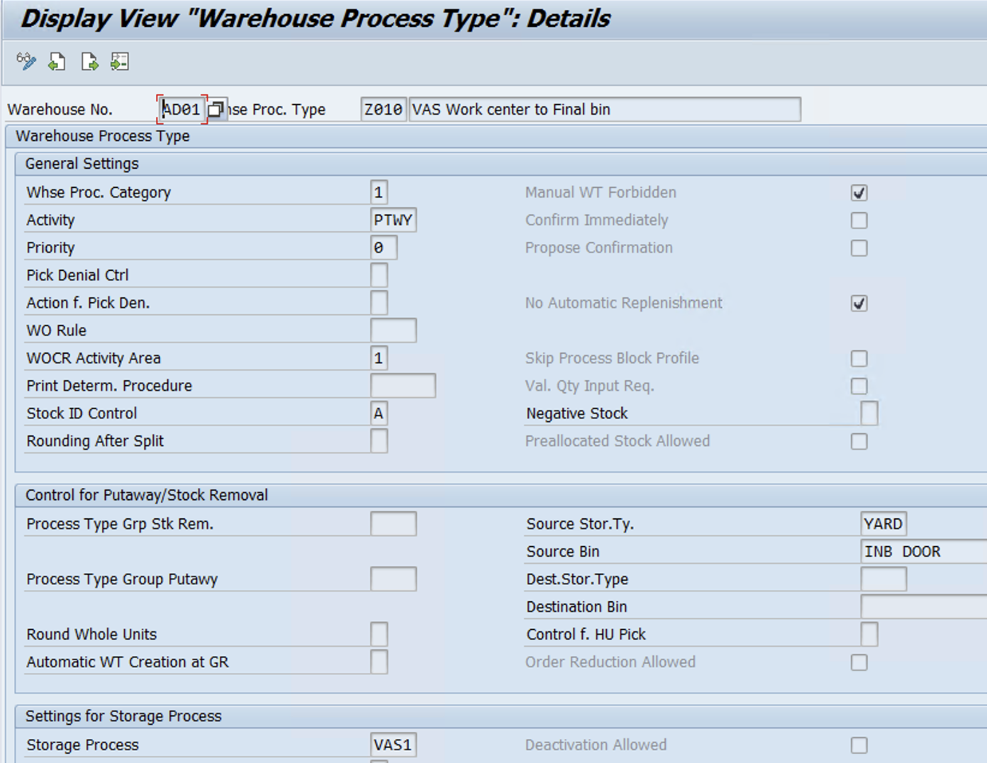
Warehouse Process Type-Z010 (VAS work center to Final put-away bin)
www.anubhavtrainings.com

Slide 22
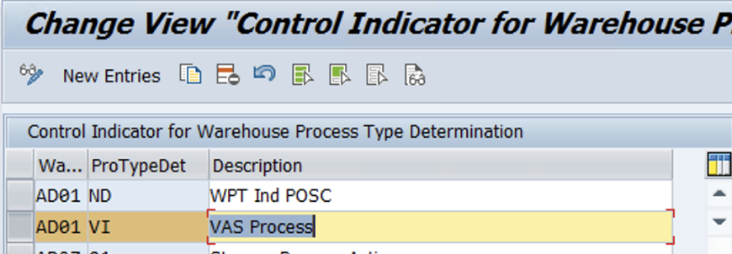
2.In the inbound delivery, the warehouse process type: Z010 should be assigned to the delivery item level.
To determine this warehouse process type, a control indicator should be defined and assigned to the respective warehouse process type.
Assign this control indicator to the respective document type, item type and warehouse process type
www.anubhavtrainings.com

Slide 23
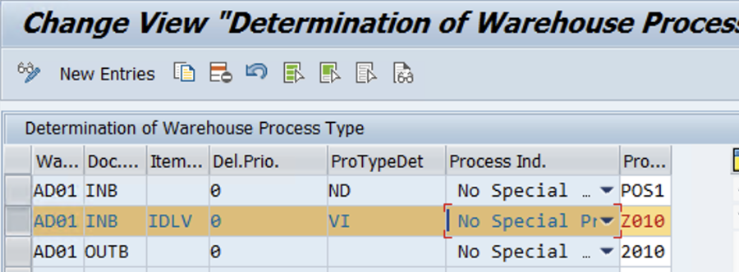

Slide 24
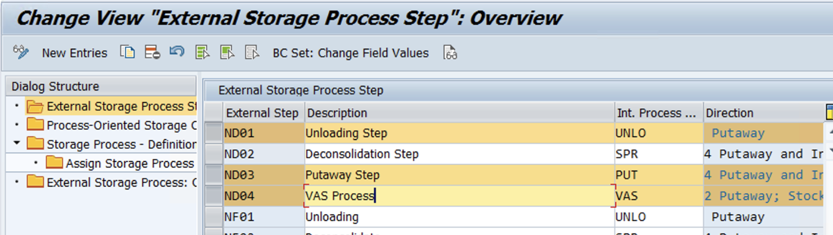
3.POSC Configuration
Define External Step -

Slide 25
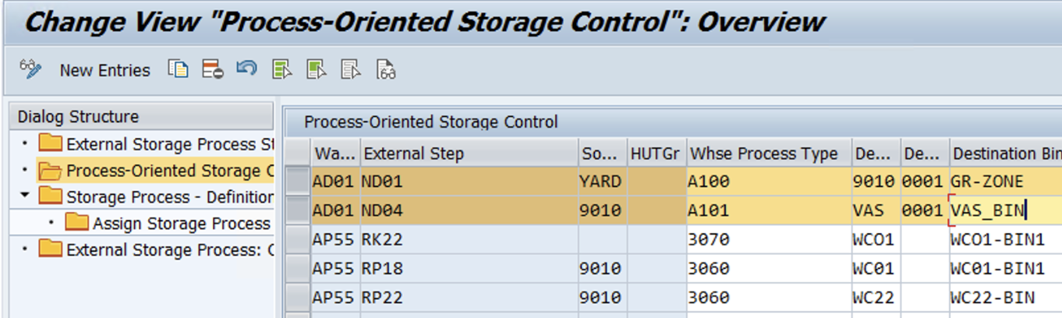
Define POSC
www.anubhavtrainings.com

Slide 26
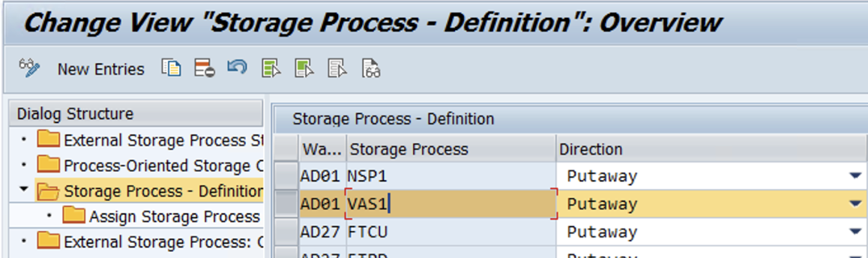
Storage Process assignment
www.anubhavtrainings.com

Slide 27
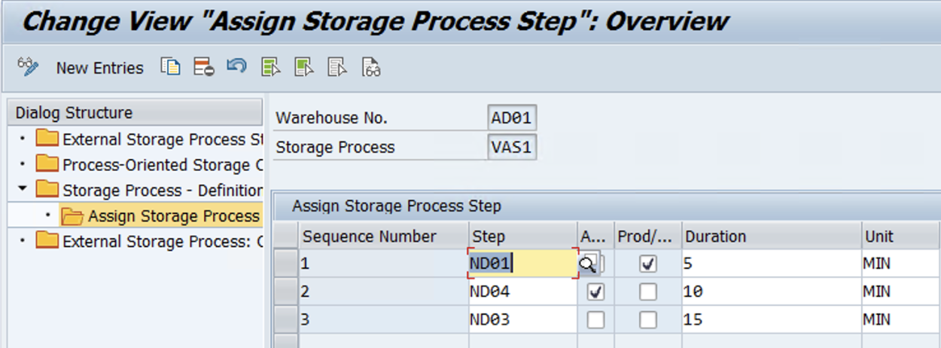
Assign Storage Process Steps
www.anubhavtrainings.com

Slide 28
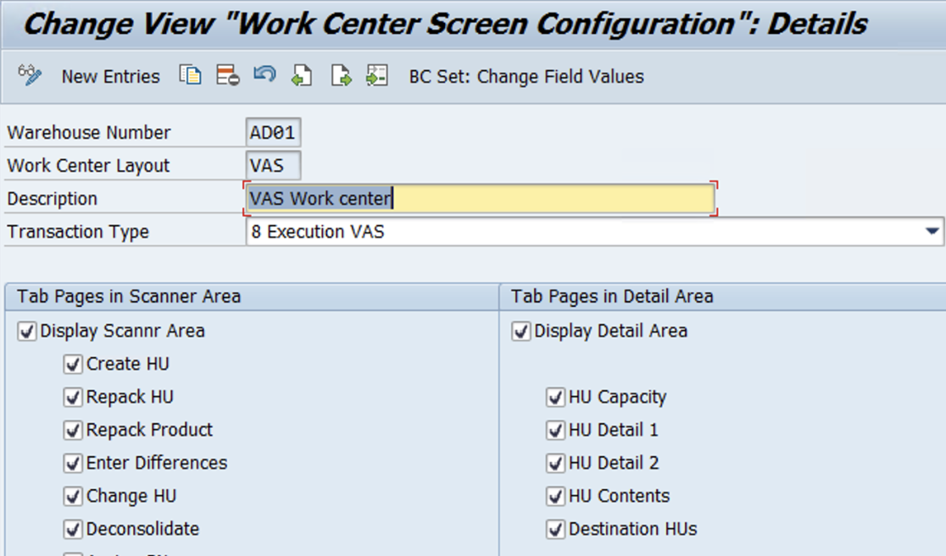
4.VAS Work Center
Work center layout (Always copy from Std VAS Work center)
Assign the storage bin to the work center using the transaction code: /SCWM/TWORKST
www.anubhavtrainings.com

Slide 29
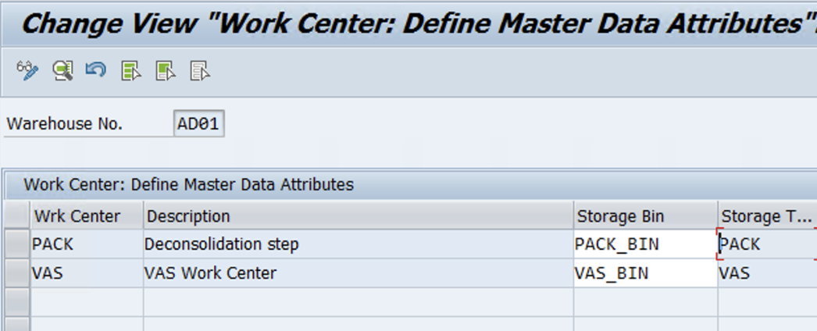
www.anubhavtrainings.com

Slide 30
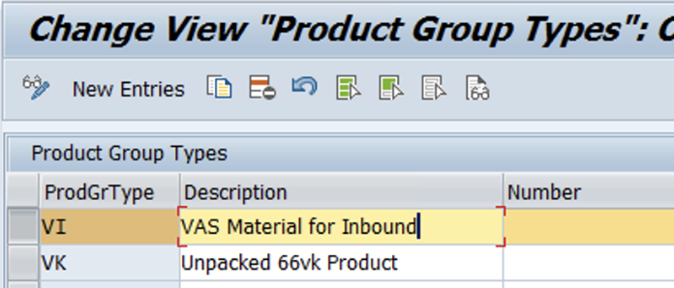
5. Define Product Group Types
IMG Path – SPRO -> IMG -> SCM Extended Warehouse Management -> SCM Basis -> Master Data -> Product -> Product Groups ->Define Product Group Types
www.anubhavtrainings.com

Slide 31
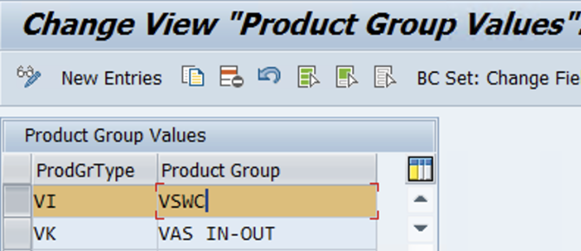
Define Product Groups
Activate order document management for VAS
IMG > EWM > Cross process > VAS > Activate order doc mgt
www.anubhavtrainings.com

Slide 32
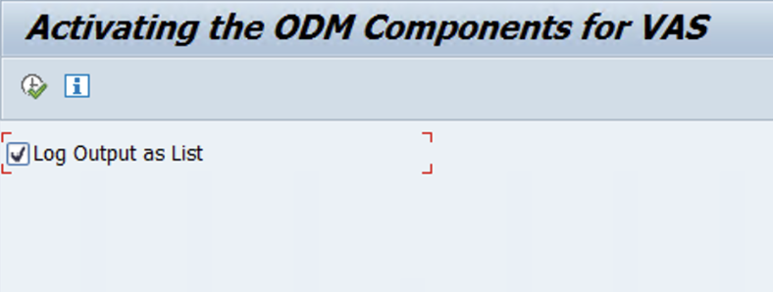
www.anubhavtrainings.com

Slide 33
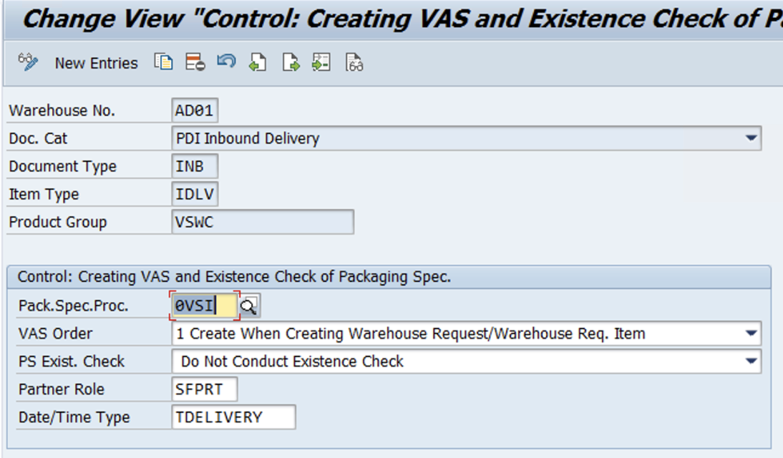
6. Define VAS Relevance by mentioning the Document type, Item type, Product Group, Pack spec Procedure, Partner Role and Date/Time Type
IMG Path – SPRO -> IMG -> SCM Extended Warehouse Management -> Extended Warehouse Management -> Cross-Process Settings -> Value-Added Services (VAS) -> Define Relevance for VAS

Slide 34
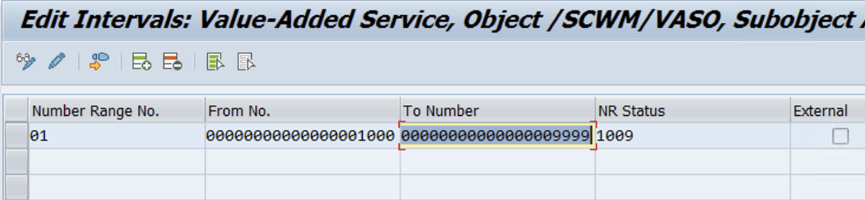
Maintain Number range for VAS Order

Slide 35
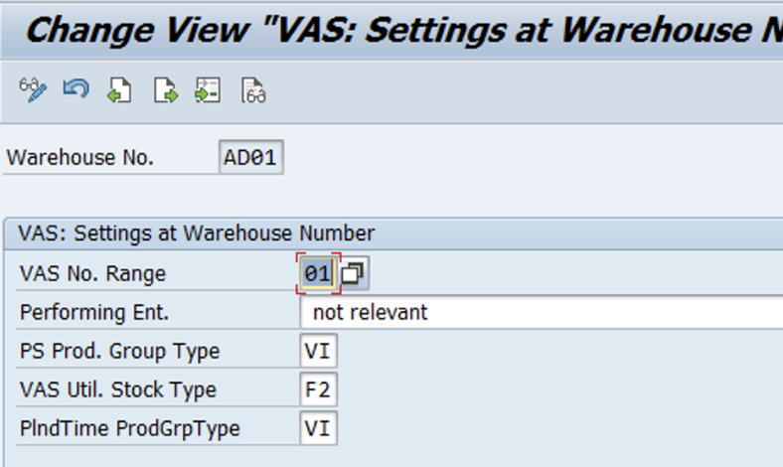
Define VAS settings for the respective Warehouse Number by assigning the Product Group Type and VAS
number range
www.anubhavtrainings.com

Slide 36
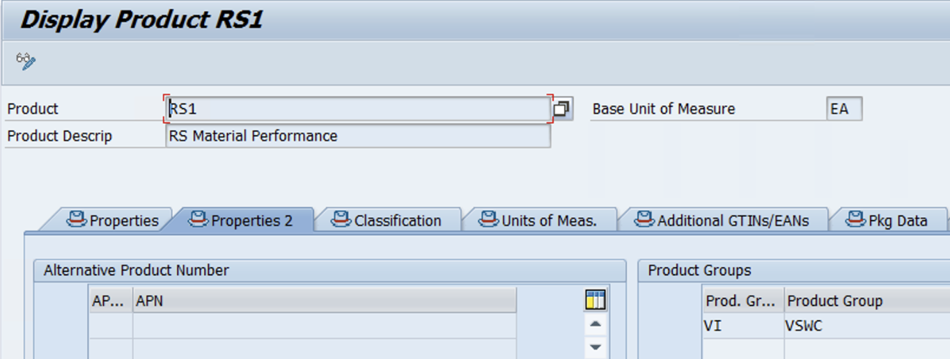
Maintain Put away Strategy Configuration to determine destination storage type
Maintain the Product Group and Product Group Type in the product master using the transaction code: /SAPAPO/MAT1
www.anubhavtrainings.com

Slide 37
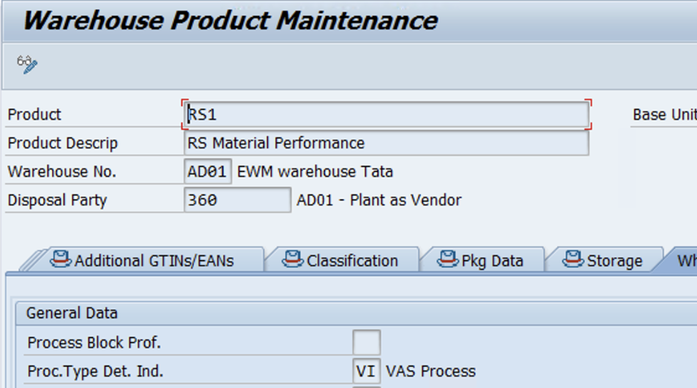
Maintain WHPT Det Ind in Product Master
www.anubhavtrainings.com

Slide 38
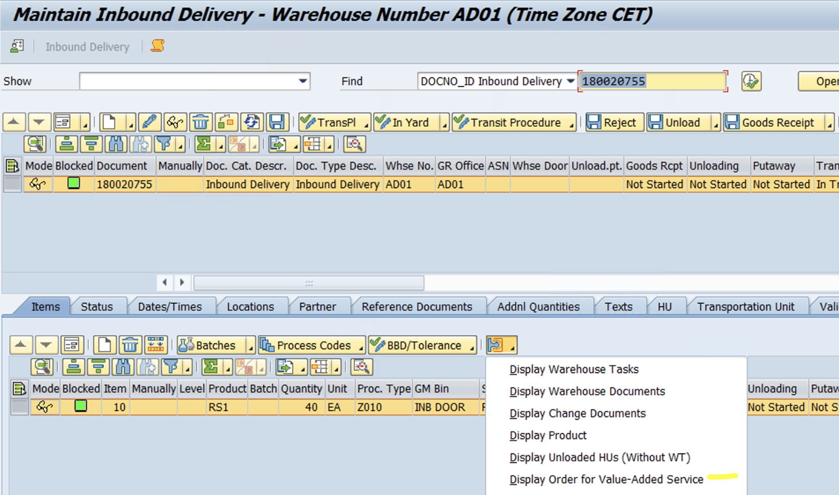
Test Case
Inbound Delivery

Slide 39
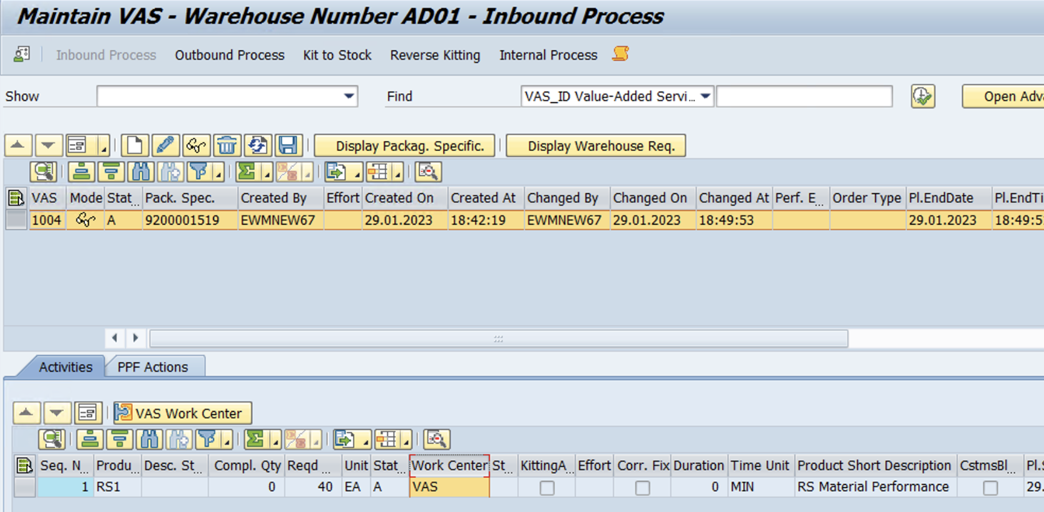
VAS Order Displayed (Check & Maintain Work Center)
Pack & Create Warehouse Task
www.anubhavtrainings.com

Slide 40
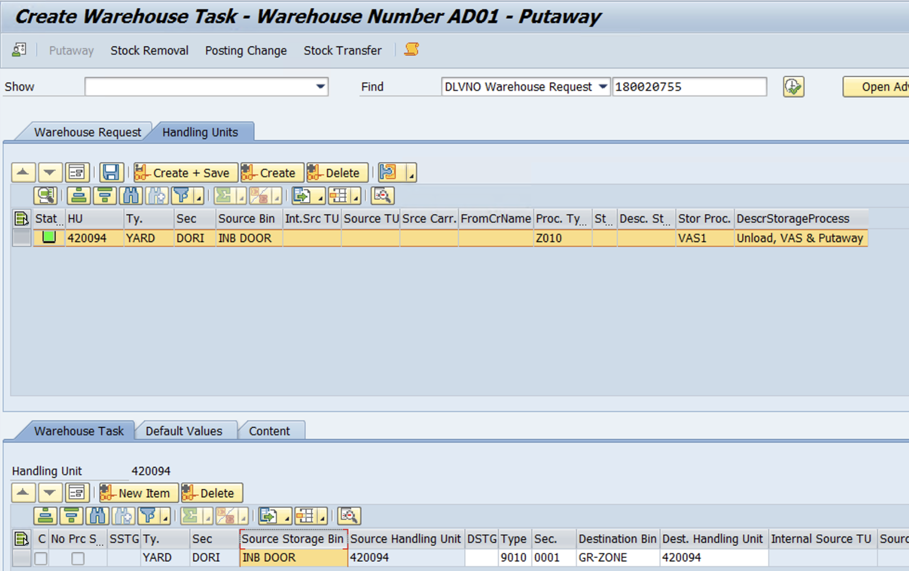
www.anubhavtrainings.com

Slide 41
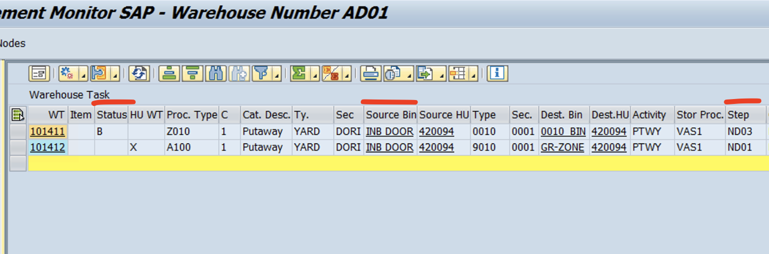
2 WTs created,
WT 101411 – From St type Door to Destination Bin (**Waiting Status)
WT 101412 – From Door to GR Zone

Slide 42
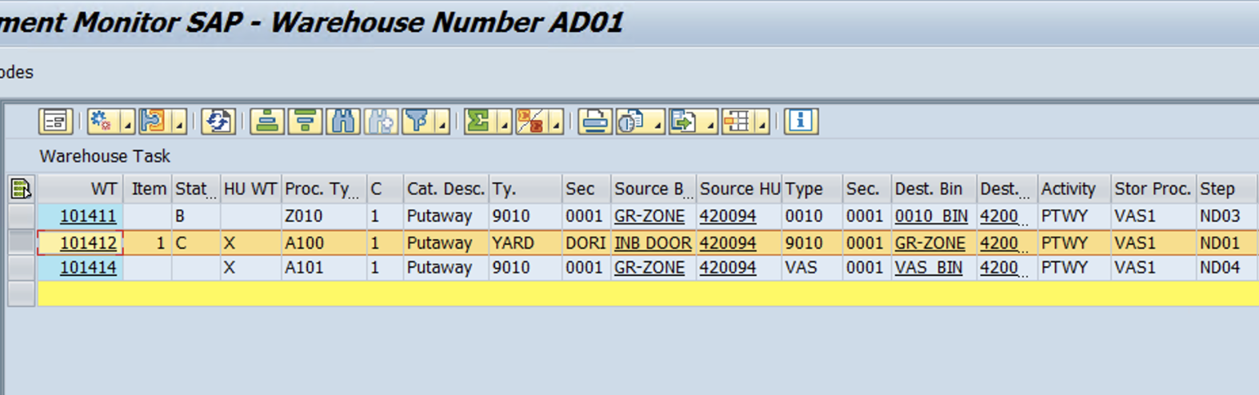
Now Confirm the WT 101412 (Door to GR Zone) >> another WT is created for GR zone to VAS work center

Slide 43
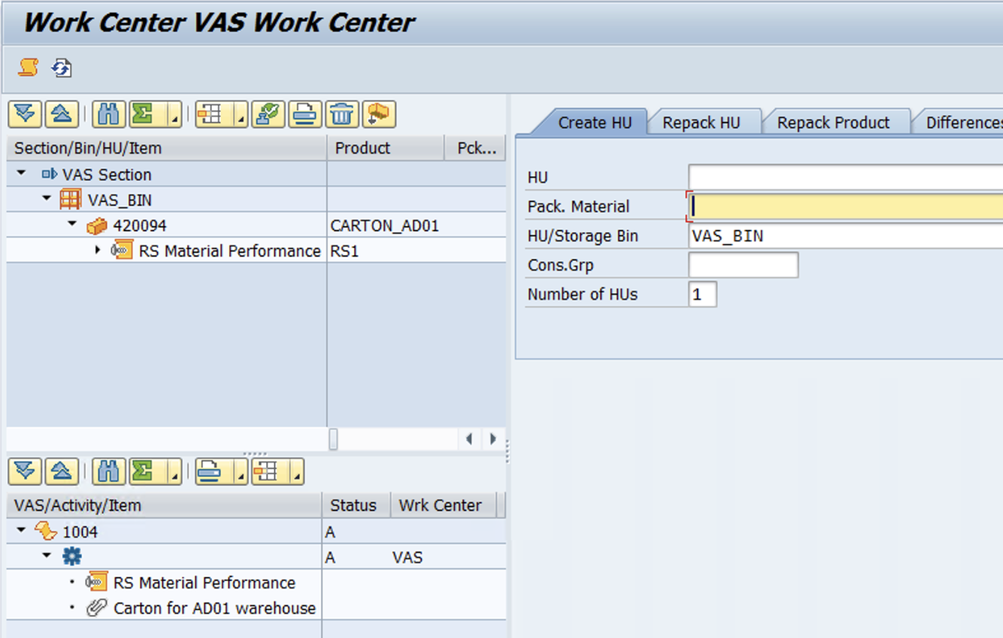
Goto Tcode - /SCWM/VASEXEC to confirm VAS order

Slide 44
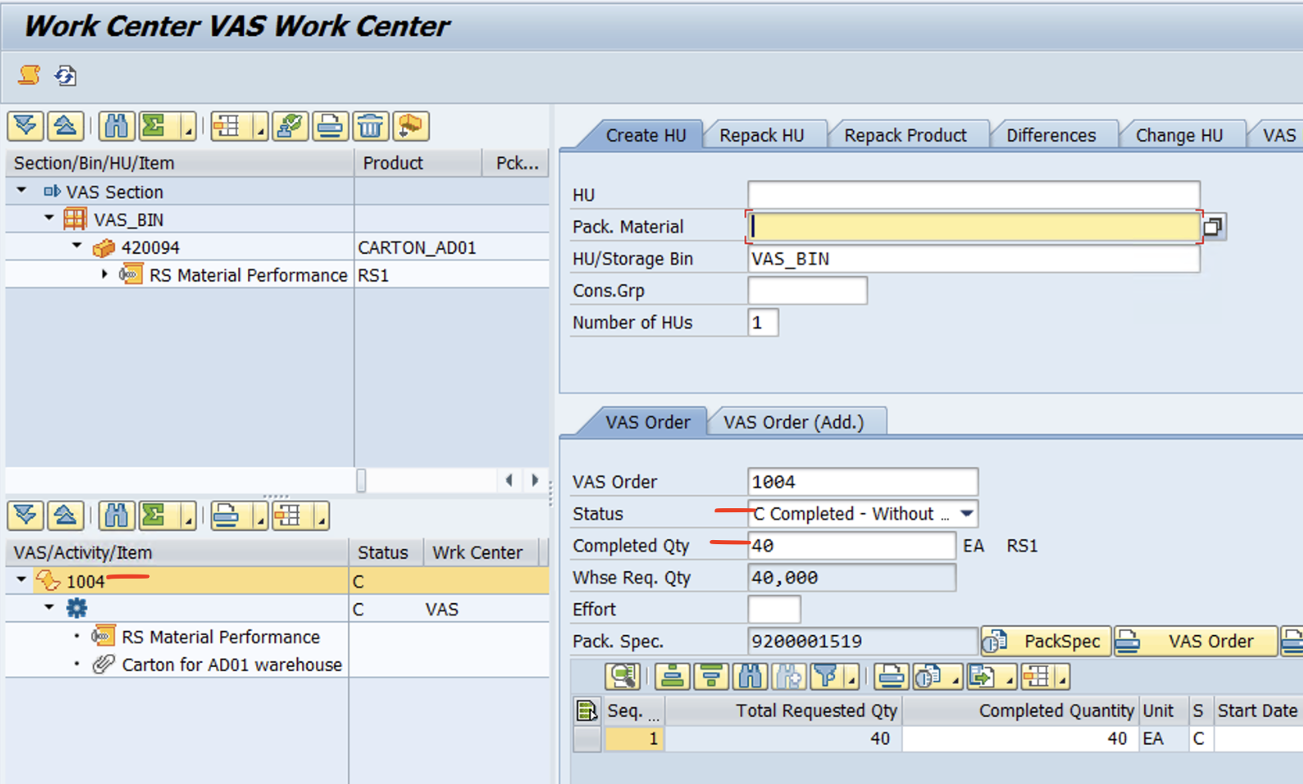
Enter the Qty and Status as “C”
Select HU & Mark it as Step Completed

Slide 45
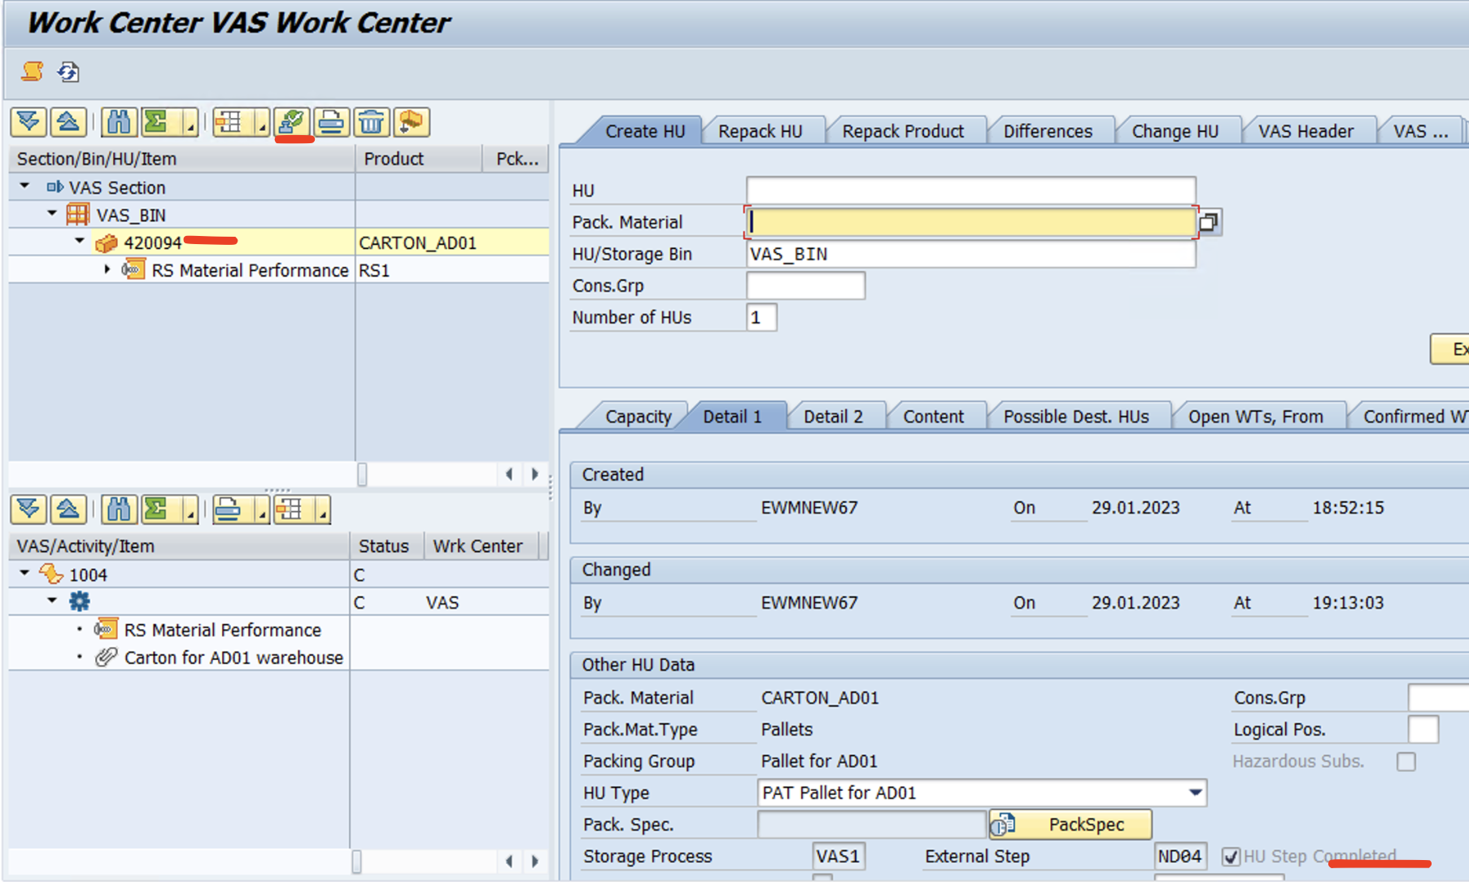
Goto Warehouse Monitor and Observe WT which was in Waiting status (B) …. has been removed and Source details updated as VAS Work center.

Slide 46
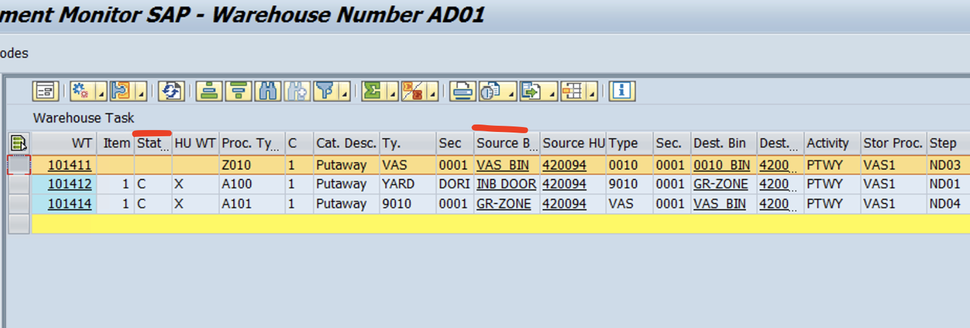
Goto Warehouse Monitor and Observe WT which was in Waiting status (B) …. has been removed and Source details updated as VAS Work center.

Slide 47
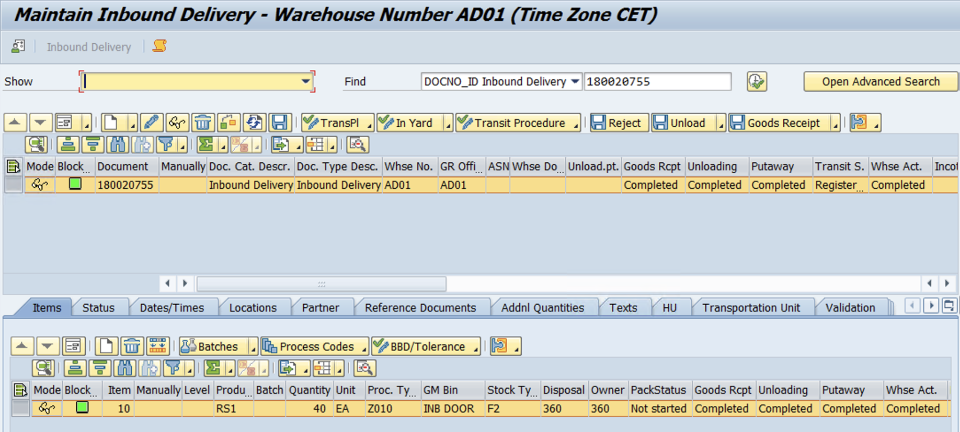
Now Confirm the WT and Check the Status in Inbound delivery

Slide 48


End of Session
www.anubhavtrainings.com

Slide 49

FEEL FREE TO ASK QUESTIONS

Slide 50

Feedback

Slide 51
THANK
YOU

Slide 52




More from AnubhavTrainings.com

Slide 53






We’re committed to empower you to be
#FutureReady
through powerful training solutions.
We build the workforce of the future.
250+
Corporate Clients
30,000+
Learners Trained
25000+
Learners Placed
FREE WEBINARS
Sign up for free webinars with industry experts every fortnight!
Enroll Now!

Slide 54
FREE WEBINARS
Sign up for free webinars with industry experts every fortnight!
Contact us today!
www.anubhavtrainings.com

